Slide 1
Fitness Bud(2nd deliverable)
By: Theodore Tsimiklis, George Athanasatos, Shawn Gregory

Slide 2
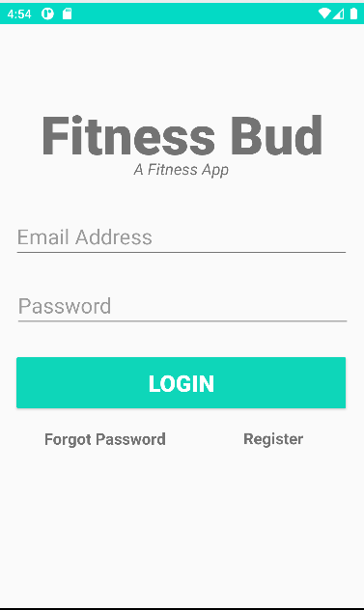
Login Page
When the app opens the user is prompted to login where they have to enter their email and password.
As well as being able to register or changing their forgotten password

Slide 3
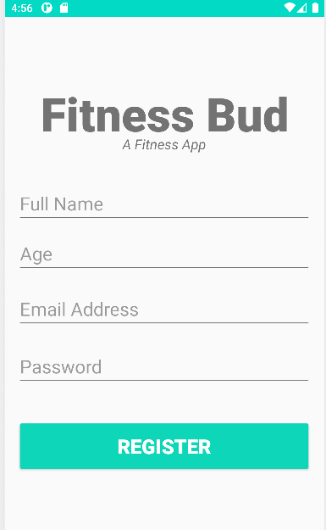

Register Page
When the user taps register, they are prompted to a new page where they have to enter 4 things
Full name
Age
Email Address
Password
All text fields must be filled and each fields has its own error message if its not filled
The banner can also be clicked to go back to the login page

Slide 4
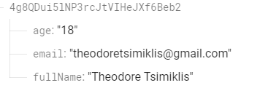
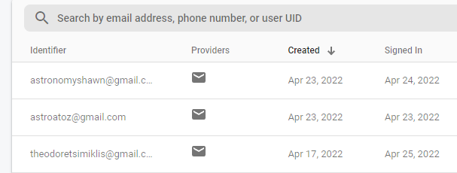
Register Continuation
After the user clicks Register their data is store in a firebase database.
Email
Full name
Age

Slide 5
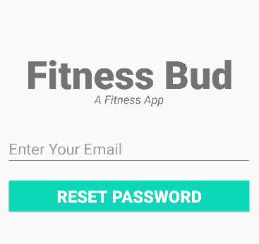
Forgot Password Page
If the user forgot their password they can choose to reset it with the email they used. It will send an email to the email inputted with the way to reset the password.

Slide 6
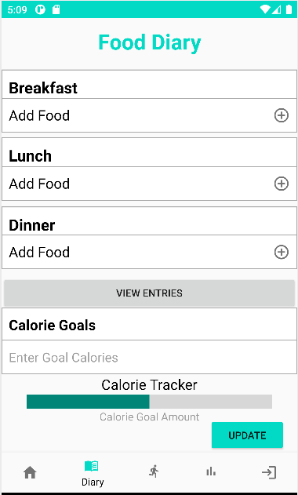
Diary page
When the user is logged in they will be able to use the bottom nav bar to traverse through the app.
On this page, the user will be able to add a food item as well as adding the calories to that food item which will save to an SQLite database.
There is also a calorie tracker that will grab the calories from the database and update it on the progress bar where the user set their calorie goals.

Slide 7
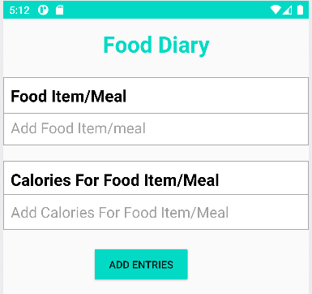
Add Food Page
This is what the add food page looks like
It is the same for breakfast, lunch, and dinner

Slide 8
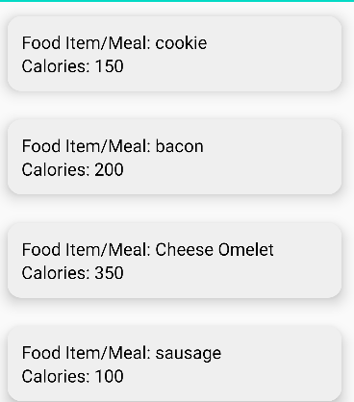
The view entries Page
In this page the entries that user put for the food and calories will be added here and displayed through a cardview with recyclerview.
A swipe to delete will be soon added.
For the progress bar it will grab the calories from here and use it to add on to the calories in the progress bar

Slide 9
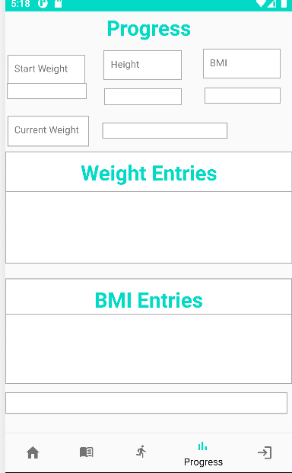
Progress page(design only)
The progress page is still a work in progress but will basically take the users weight and give them their BMI.

Slide 10
Home Page/Exercise Page
These Page still haven’t been implemented yet and are going to be completed for the final demo.

